Slide 1
Training responsible engineers for global contexts
William J. Frey
Professor of Business Ethics
College of Business Administration
University of Puerto Rico at Mayaguez

Slide 2
Frameworks
Appropriate Technology
“technology “intermediate” between the “indigenous technology of developing countries and developed country or high capital intensive technology”(Schumacher, Small is Beautiful, 188-201)
Capabilities
“What is this person able to do or be?”; “Substantial freedoms … to choose and act.” (Nussbaum, Creating Capabilities, 20, 33-34)
Socio-Technical System
“an intellectual tool to help us recognize patterns in the way technology is used and produced” (Huff, “What is a Socio-Technical System?” from Computing Cases)

Slide 3
Techno-Socio Sensitivity
Respon-sibility Skill | Description | Module | Activities
Techno-socio sensitivity Socio-Technical Systems in Professional Decision Making (m14025 from Connexions) Responsible Choice for Appropriate Technology (m43922) | “critical awareness of the way technology affects society and the way social forces in turn affect the evolution of technology” CE Harris, (2008), “The good engineer: Giving virtue its due in engineering ethics,” Science and Engineering Ethics, 14(2): 153-164. | Socio-technical Systems 1. Different environments constrain and enable activity. 2.System of distinguishable but interrelated and interacting parts. 3. Embody / express moral and non-moral values. 4. Normative objective = tracing out a value positive path or trajectory of change. | Identifying sub-environments How each constrains activity How each enables or instruments activity Value vulnerabilities and conflicts Plot out system trajectories or paths of change

Slide 4
Responsible Technological Choice
Students assigned cases of technological choice
Start with STS analysis
Examine how communities choose and enact their technologies
Pivots to Puerto Rico
Cases paired with cases from Puerto Rico
For case studies on technological choice, see:
Johnson and Wetmore, Technology and Society: Building Our Sociotechnical Future, MIT Press, 2009

Slide 5
Responsible Technological Choice
AT Case | Pivot to PR | Frameworks
One Laptop Per Child | Laptops to Teachers | Restore / Preserve interpretive flexibility Labor Intensive Simple De-centralized
Removing gender bias from airplane cockpit design | Removing social injustice from gas pipeline design
Uchangi Dam (eng as honest broker) | Engineers as Honest Brokers in PR Energy Debates
Amish (exercise of technological choice) | Vieques—Are windmills an appropriate or intermediate technology for Vieques? | Values in technology “fit” those embedded in STS
Aprovecho Case (NGO designs and tests wood-burning cooking stoves) | Are wood-burning stoves an appropriate technology? Is there a need for these stoves in PR? Would PR be a good regional center for testing stoves? | Technology serves as “conversion factor” in the conversion of capabilities into functionings
Waste for Life (Press that makes building materials out of waste products) | Using STS analysis to explain difference between Lesotho success and Buenos Aires failure

Slide 6
Capabilities Approach
“help answer the question, “What is this person able to do or be?”
“Substantial freedoms, causally interrelated opportunities to choose and act.”
“They are not just abilities residing inside a person but also freedoms or opportunities created by a combination of personal abilities and the political, social, and economic environment.”
Paradigm Shift
Replace view that these communities are deficient (have needs…) with view that communities are repositories of capabilities and resources that can be engaged.
Martha Nussbaum. Creating Capabilities: The Human Development Approach. Belknap Press of Harvard University Press, 2011, 20, 33-34. Martha Nussbaum. Frontiers of Justice: Dksability, Nationality, Species Membership. Beknap Press of Harvard University Press, 2006, 76-78.

Slide 7
Types of Capabilities
Basic Capabilities
Life
Bodily health
Bodily integrity
Cognitive Capabilities
Senses / imagination / thought
Emotions (“not having one’s emotional development blighted by fear and anxiety”)
practical reason (liberty of conscience and religious observance)

Slide 8
Types of Capabilities
Social or Out-reaching Capabilities
Affiliations
“live with and toward others, to recognize and show concern for other human beings, to engage in various forms of social interaction; to be able to imagine the situation of another(freedom of assembly and speech)
“Having the social bases of self-respect and nonhumiliation; being able to be treated as a dignified being whose worth is equal to that of others (nondiscrimination)
Other Species
“Being able to live with concern for and in relation to animals, plants, and the world of nature.”

Slide 9
Types of Capabilities
Agent Capabilities
Play
Control over one’s environment
“Political.
Being able to participate effectively in political choices that govern one’s life; having the right of political participation, protections of free speech and association.”
Material.
Being able to hold property (both land and movable goods), and having property rights on an equal basis with others;
having the right to seek employment on an equal basis with others;
having the freedom from unwarranted search and seizure.
In work being able to work as a human being, exercising practical reason and entering into meaningful relationships of mutual recognition with other workers

Slide 10
Conversion Factors
Means that realize capabilities into functionings
Resources, tools, technologies
Personal
Metabolism, physical condition, sex, reading skills, gender, race, caste
Social
Public policies, social norms, practices that unfairly discriminate, societal hierarchies, power relations related to class or gender, race, caste.
Environmental
Physical or built environment, climate, pollution, proneness to earthquakes, presence or absence of seas or oceans Ingrid Robeyns, "The Capability Approach", The Stanford Encyclopedia of Philosophy (Summer 2011), Edward N. Zalta (ed.)

Slide 11
Energy as Conversion Factor
Capabilities
Functionings

Slide 12
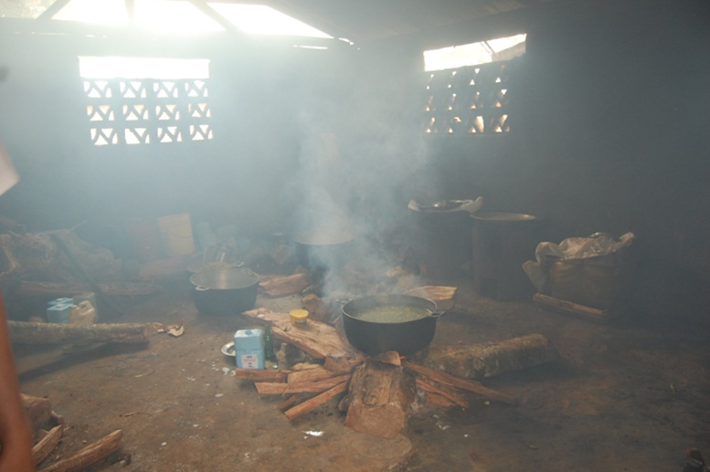
Burning Wood/Charcoal
Capabilities
Health
Control Environment
Functionings
Cooking (+), Respiration (-)
Deforestation (-)
Burning

Slide 13
Electricity
Capabilities
Health
Thought
Affiliation
Play
Functionings
Medical tools
Reading, Computing
Evening meetings
Amplified music
Electricity
The selection of generation means is further informed by
principles of Appropriate Technology
accounting for underlying Socio-Technical System
all of which requires community dialogue and partnership

Slide 14
Social Technical Systems (STS)
STS’s consist of various components
Hardware, software, physical surroundings, people/groups/roles, procedures, laws/statutes/regulations, and information systems
STS’s are systems
Components are inseparable
STS’s embed values
Extension of idea that technology is not neutral
STS’s can change
Trajectories can indicate changes that is value-positive or value-negative

Slide 15
Baseline STS
Hardware | Physical Surroundings | People | Procedures | Laws | Cultural Matters
Diesel Generator Electricity Wiring Individual Generators | Poor road conditions Mountainous conditions | Electric Committee Private individuals Youthaiti Rotary Club, St. Thomas | Maintaining generator Making Charcoal | Eng Codes Little govt regulation Hours of usage | French Creole Social strata

Slide 16
Expanded STS
Hardware | Physical Surroundings | People | Procedures | Laws | Cultural Matters
Diesel generator Electricity wiring Individual Generators Hydro-electric plant PV panels | Poor road conditions Mountainous conditions Glace River (and gorge) Rooftops | Electric committee Private individuals Youthaiti Rotary Club, St. Thomas UPRM NSF | Maintaining generator Making charcoal Cultivating jatropha? | Eng Codes Little govt regulation Hours of usage Cooperative managem’t or sharing | French Creole Social strata Low literacy rate Agrarian

Slide 17
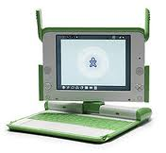
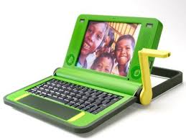
Responsive Technological Choice:
One Laptop Per Child
http://en.wikipedia.org/wiki/OLPC_XO-1
/
K. Kraemer, J. Dedrick, andP. Sharma
“One Laptop Per Child: vision vs. Reality”
Communications of the ACM 52(6): 66-73
http://en.wikipedia.org/wiki/OLPC_XO-1

Slide 18
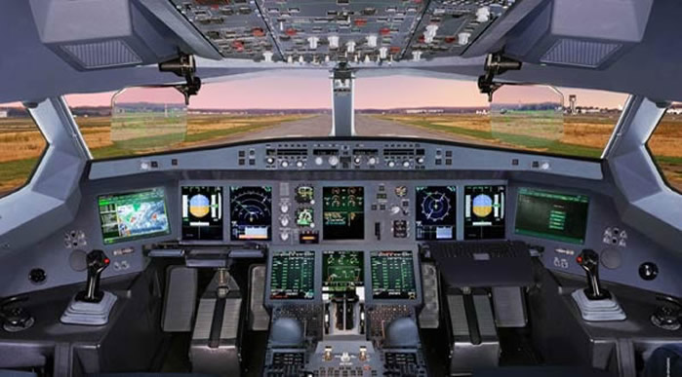
Responsive Technological Choice: Case 2
Redesigning airplane
cockpits to remove
gender bias
http://www.aviationexplorer.com/a350_facts.htm
Manufacturing Gender in Commercial and Military Cockpit Design Rachel N. Weber Science, Technology, & Human Values, Vol. 22, No. 2. (Spring, 1997), pp. 235-253.http://www.jstor.org Tue Jan 2 16:14:06 2007

Slide 19
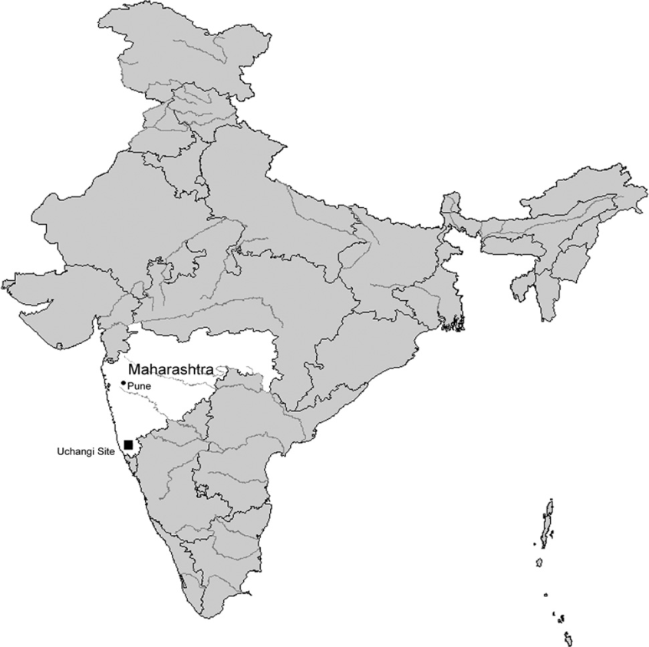
Responsive Technological Choice: Case 3
Bridging the gap between government and local
communities in the Uchangi Dam Project
How engineers and other professionals with
NGOs can serve as mediators or honest
brokers in disputes on technological choice
Professionals work with local
communities to “give them voice.”
Roopali Phadke. “People’s Science in Action: The Politics of Protest and Knowledge
Brokering in India.” In Tecnology and Society, Johnson and Wetmore eds. MIT Press, 2009, 499-513.

Slide 20
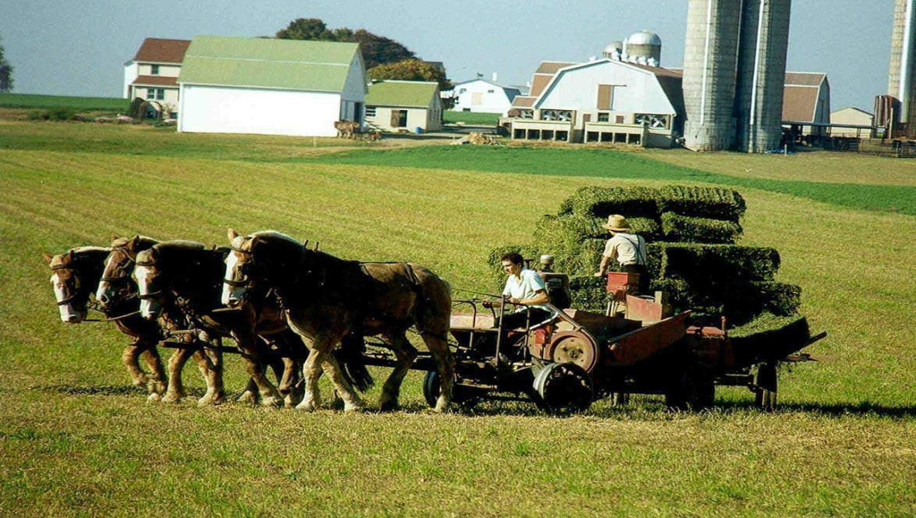
Responsive Technological Choice: Case 4
How the Amish adopt and adapt technology
Using technological choice to build a
community’s identity
Assessing how a technology would impact a
community’s core values
Modifying existing technology to minimize
negative impact on a community’s values
http://amishbeat.wordpress.com/
Jamison Wetmore. “Amish Technology: reinforcing Values and Building Community” in Technology and Society, eds. Johnson and Wetmore. 2009, MIT Press: 298-318

Slide 21
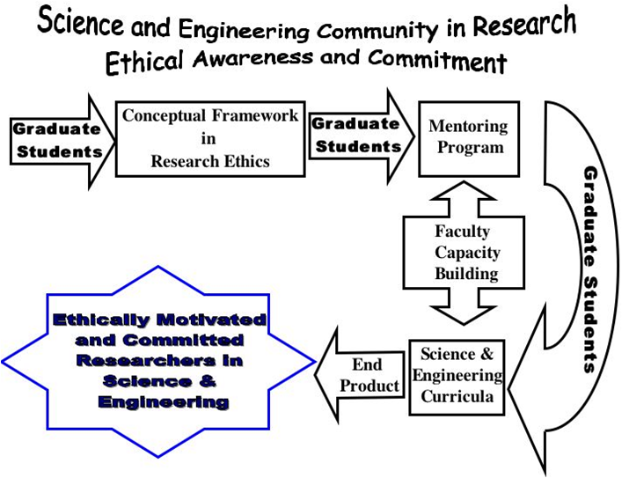
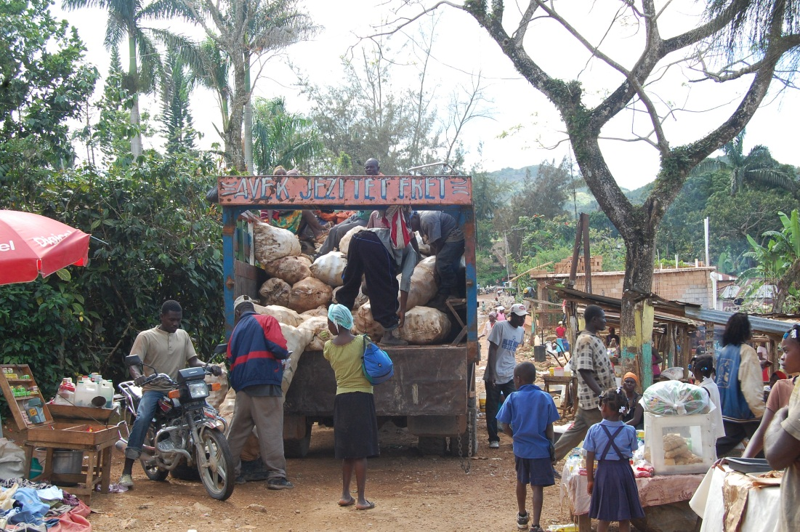


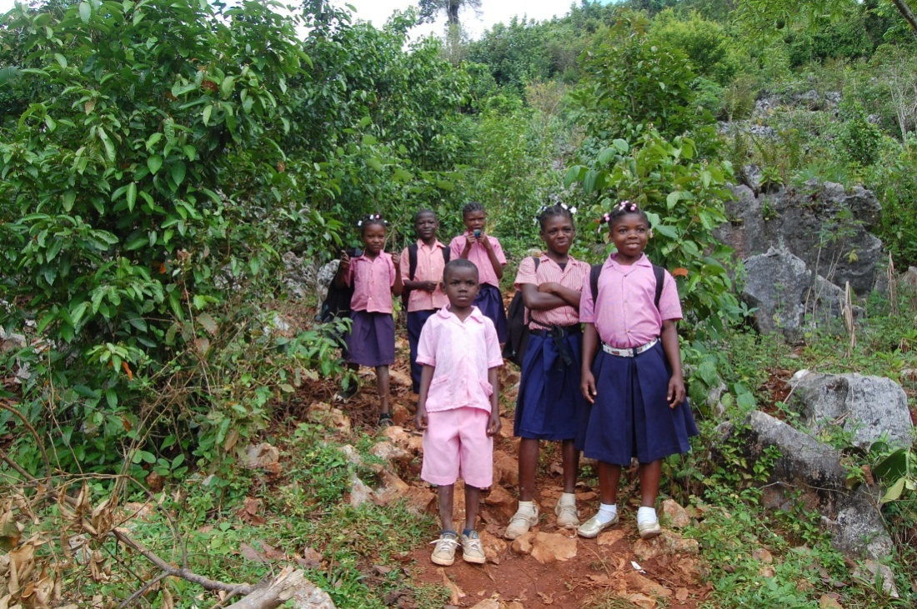
Thank-You
William J. Frey, College of Business Administration, University of Puerto Rico at Mayaguez
Moral Imagination
Realizing capabilities
Understanding Moral Expertise
Developing profitable partnerships
to alleviate poverty

Slide 22
Starting a Toolkit for GREAT IDEA
http://cnx.org/content/col10552/1.3 “Socio-Technical Systems in Professional Decision-Making”
http://cnx.org/content/m43922/latest/?collection=col10552/1.3 “Responsible Choice for Appropriate Technology”
http://cnx.org/content/col10552/1.3 Collection: “Engineering Ethics Modules for Ethics Across the Curriculum”

